Slide 1
Standards for Microbiome and Metagenomic Measurements
MML Microbial Metrology Mission Statement
“To develop advanced measurements that will permit the exploitation of microbes to promote human health, precision medicine and advanced manufacturing”
Scott Jackson
Leader, Complex Microbial Systems Group
Biosystems and Biomaterials Division
MML

Slide 2


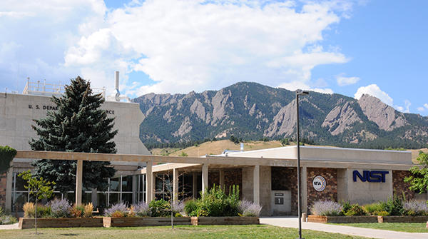
What/Who Is NIST?
Non-regulatory federal agency within the U.S. Department of Commerce.
Located in Gaithersburg, Maryland and Boulder, Colorado
~5000 Scientists and Engineers (4 Nobel Laureates)
Founded in 1901
~$1B Annual Budget
NIST's Mission: “To promote U.S. innovation and industrial competitiveness by advancing measurement science, standards, and technology”

Slide 3

https://MicrobialStandards.org

Slide 4
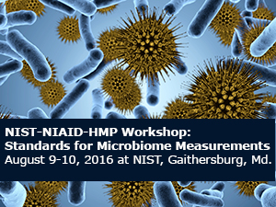
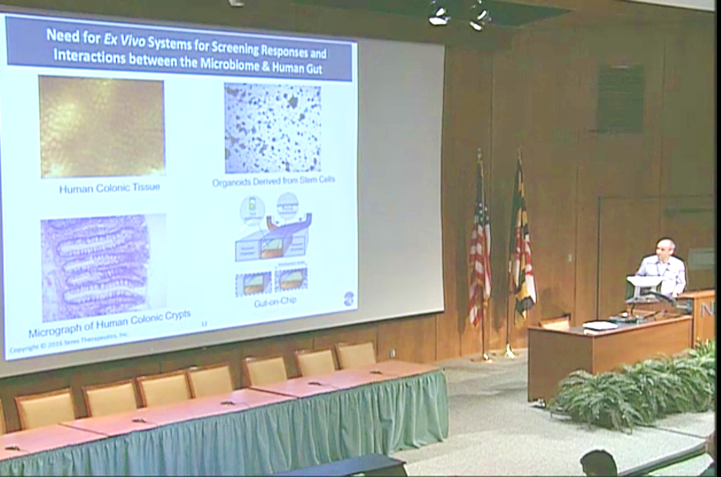
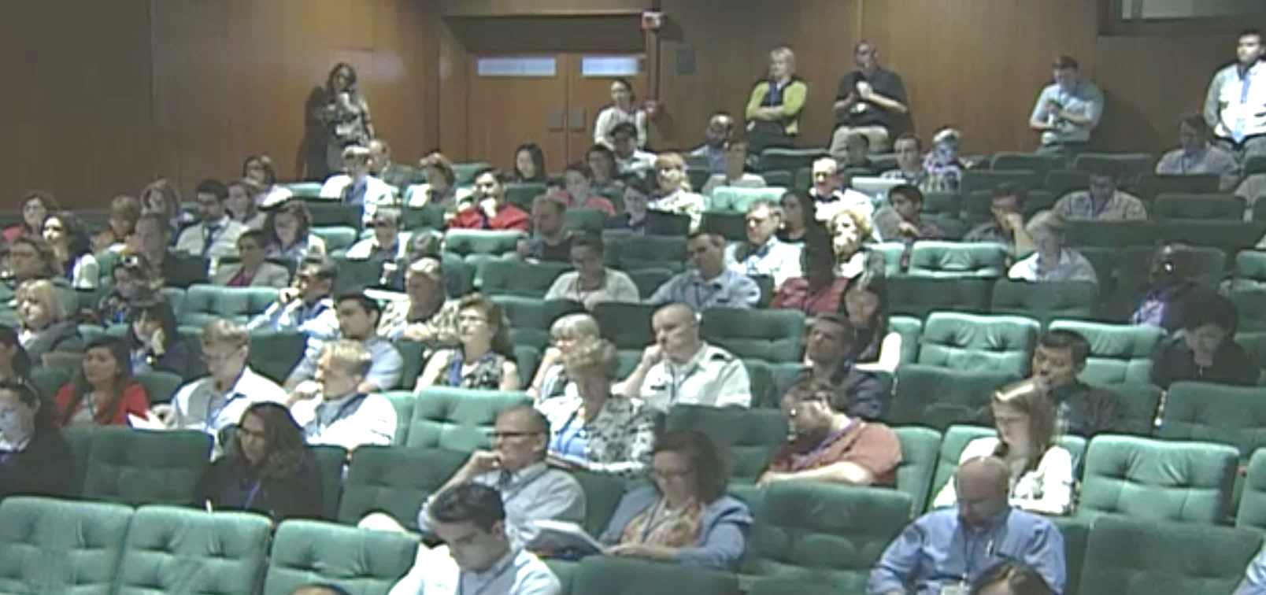
The 2016 NIST-NIH Standards for Microbiome Measurements Workshop
“This workshop will seek input on defining reference materials, reference data and reference methods for human microbiome community measurements.”
Attended by ~200 international scientists
Speakers included leading experts from academia, industry and government
Focused exclusively on DNA-based measurements of human microbiome for health and disease applications

Slide 5
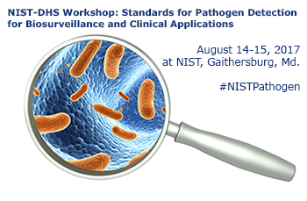
NIST-FDA-DHS Standards for Pathogen Detection for Biosurveillance and Clinical Applications Workshop

Slide 6
Coming 2019
Standards for Metagenomic Measurements

Slide 7
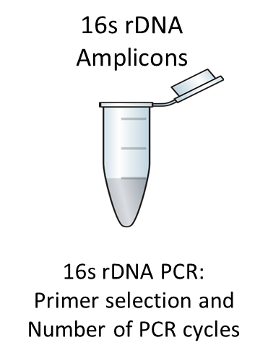
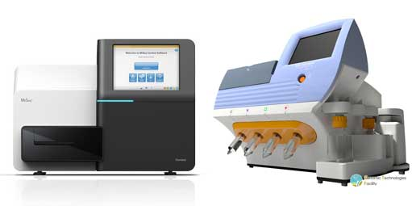
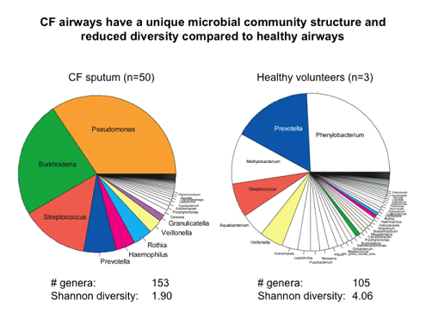

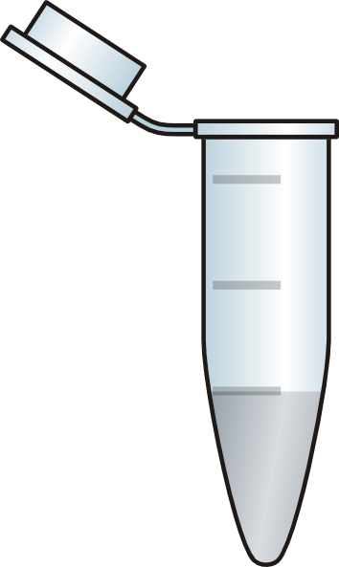
Bias in Metagenomic Measurements
Starting Sample
Total DNA
16S PCR
DNA Extraction
Bioinformatics
NGS
NGS Library
Shotgun Metagenomics
Sample Handling:
Isolation
Storage
Shipping
DNA Extraction Efficiency:
Different Extraction Efficiencies from Different Cell Types.
Different DNA Extraction Methods (bead beating vs. enzymatic vs. chaotropic, etc.)
Extracellular Matrix “Goop”
Bioinformatic Interpretation of the NGS Data:
Different Bioinformaticists Analyze and Interpret the Data Differently
Next-Gen Sequencing:
Different Platforms Exist. Each With Inherent Biases
Transposon
Mechanical Shearing
Nuclease
Adapter Ligation
PCR-Bias

Slide 8
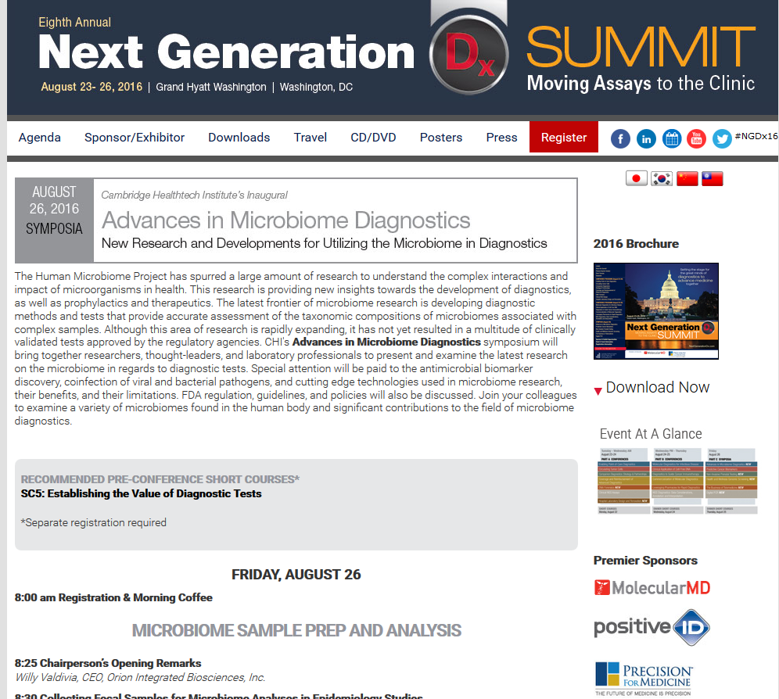

Microbiome Diagnostics
CLIA-certified and CAP-accredited clinical laboratory

Slide 9
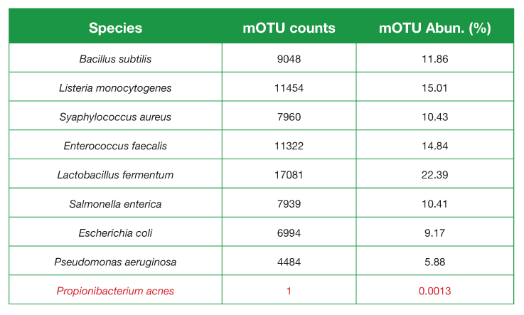
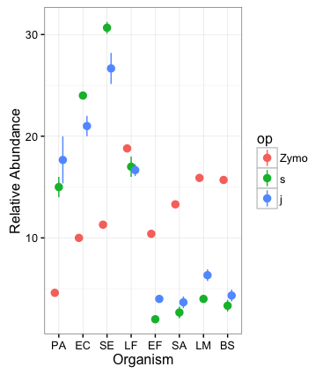
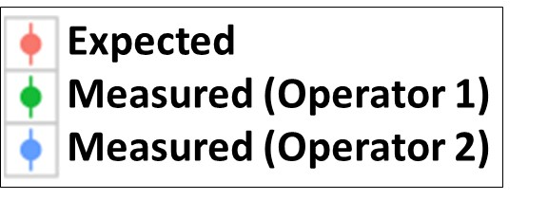
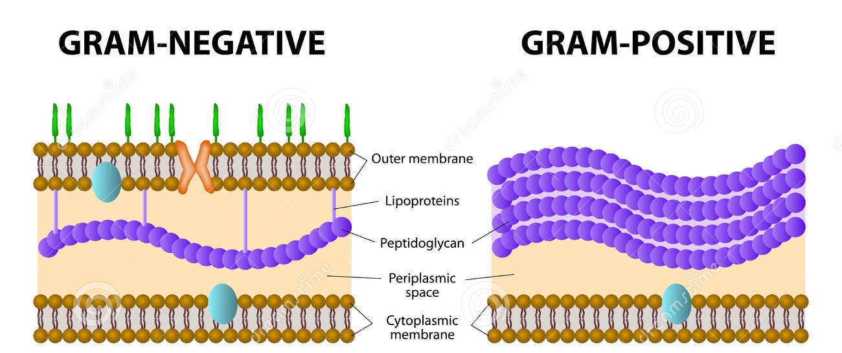
Metagenomic Measurements: Reproducibility and Bias
ZymoBIOMICS™ Microbial Community

Slide 10

Initial Results from The Metagenomic MVP Challenge v1.0
An Interlab Study Designed to Assess Bias Associated with Shotgun Library Preparation and NGS Instrument
Scott Jackson
Leader, Complex Microbial Systems Group @ NIST

Slide 11
The Rules
We provide a metagenomic DNA reference material..
We asked each participating laboratory to:
build a shotgun library
sequence the material on their NGS instrument
return their raw sequence data (fastq) to us
return metadata describing their entire sequencing technique
The only constraint we imposed was that the library had to be whole genome shotgun, not 16S amplicon, in order to make the data comparable.
We encouraged participants to use any and all library prep techniques and sequencing platforms.
Hoped to obtain data from many diverse library-prep techniques and all current NGS instruments.

Slide 12
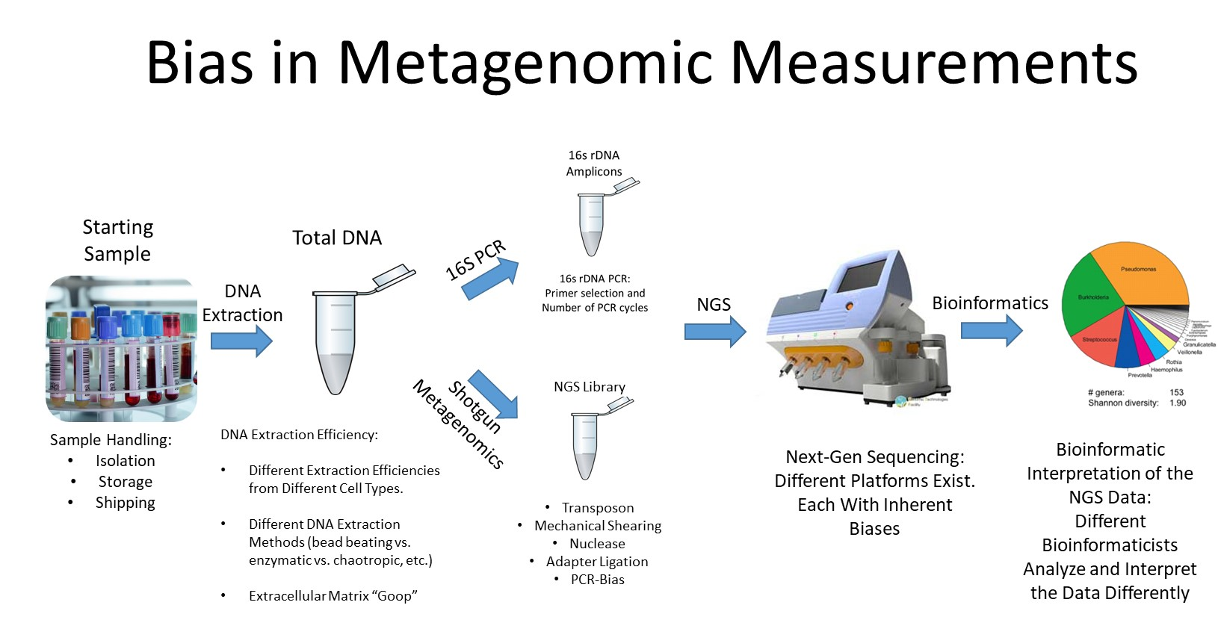

Slide 13

Our Metagenomic DNA Mixture:
gDNA from 10 Bacteria - An Equi-Genomic Mixture
Graciously Provided by Scott Tighe at ABRF
Mixture to be sequenced by participants

Slide 14
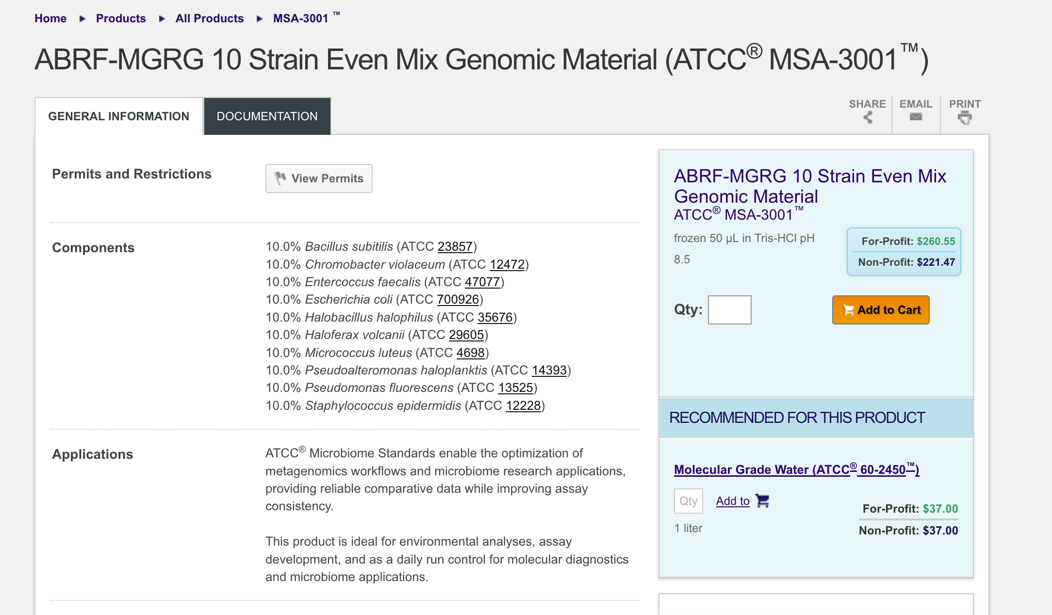

Slide 15
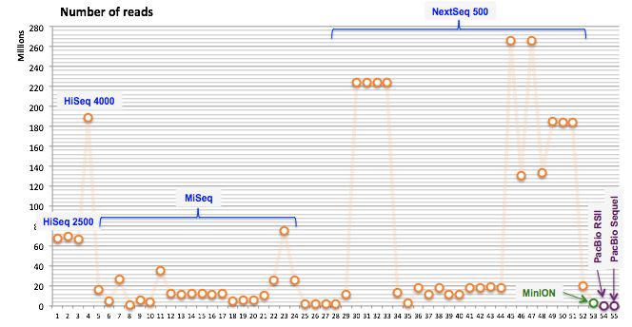
The Raw Data Submitted by Participants

Slide 16
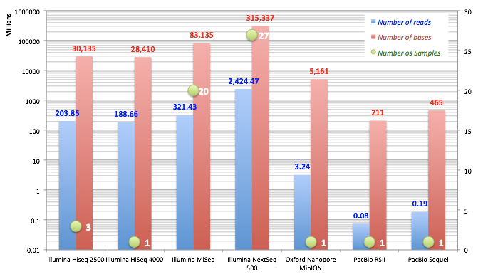
The Raw Data Submitted by Participants

Slide 17
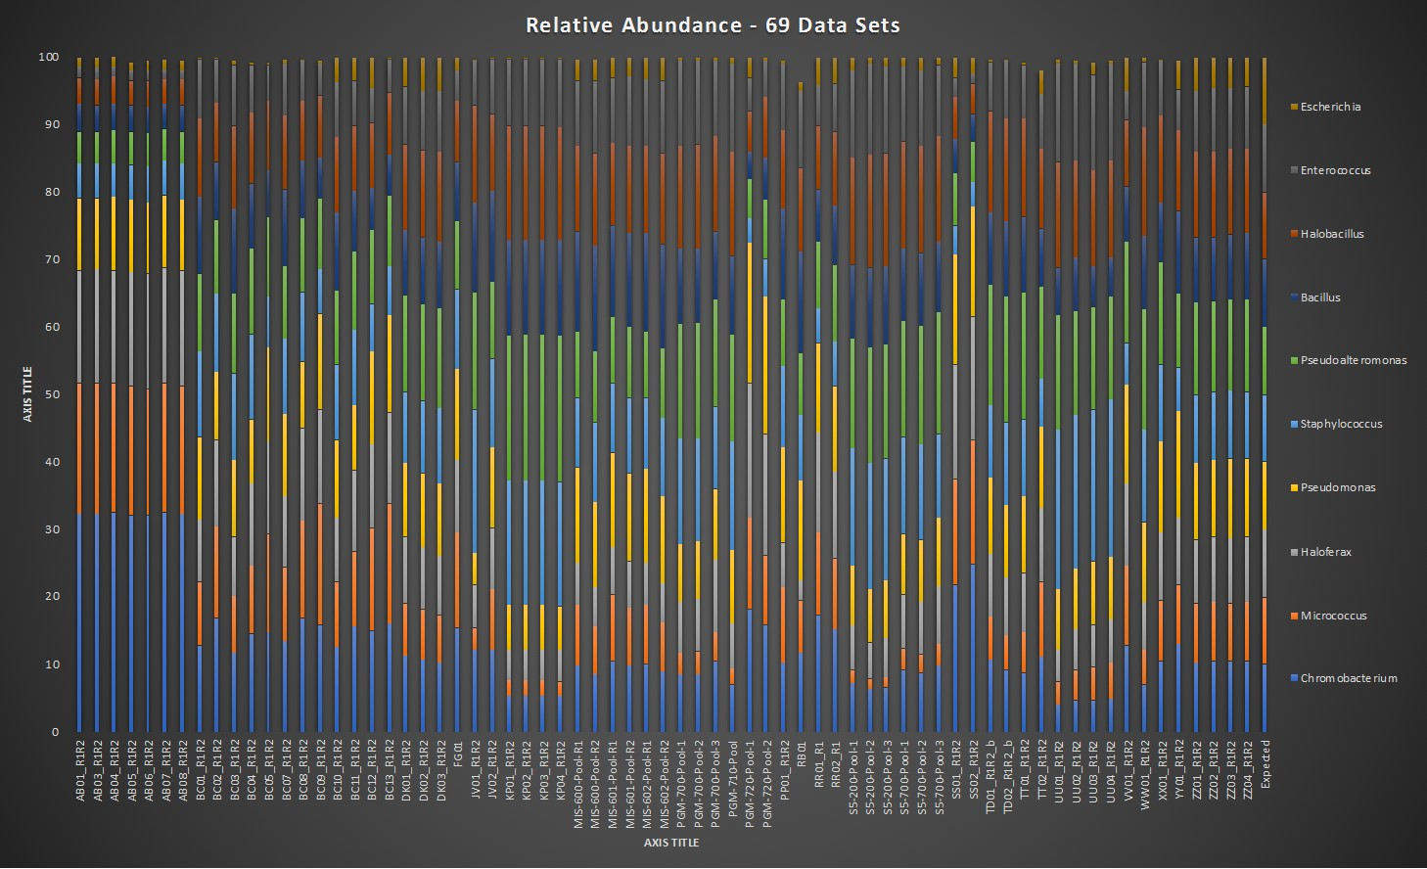

Slide 18
Performance Metrics
Qualitative vs. Quantitative

Slide 19
Qualitative Performance Metrics
Were the correct strains/species identified? TP
Were any incorrect species identified? FP
Were the species represented in the database (~10,000) not incorrectly called? TN
Were any strains missed? FN

Slide 20
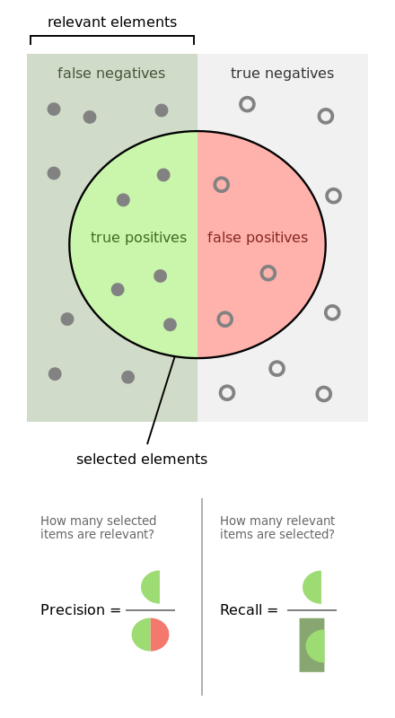
Qualitative Performance Metrics
F1 score is the harmonic mean of precision and recall

Slide 21
Genus-Level Performance

Slide 22
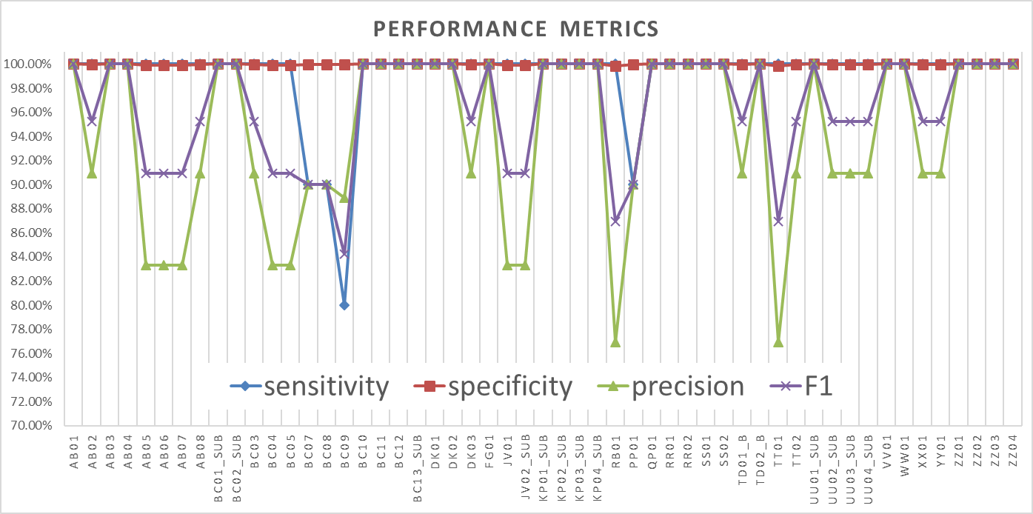
Species-Level Performance

Slide 23
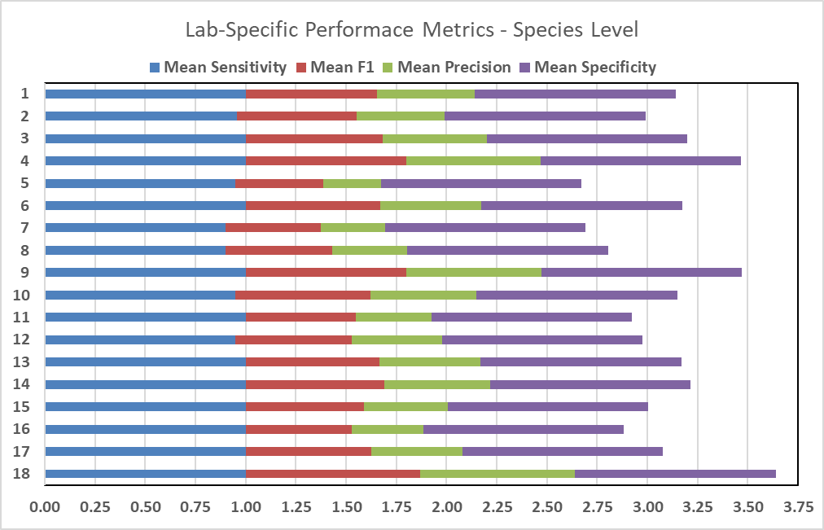

Slide 24
False Positives
Suppose you ran the same sample on two separate sequencing runs with the following conditions:
1) 10 million reads generated for the sample
2) 100 million reads generated for the sample
Would you expect 10x as many false positives in the 2nd run?

Slide 25
More Reads = More False Positives
Low FP/read ratio
High FP/read ratio

Slide 26
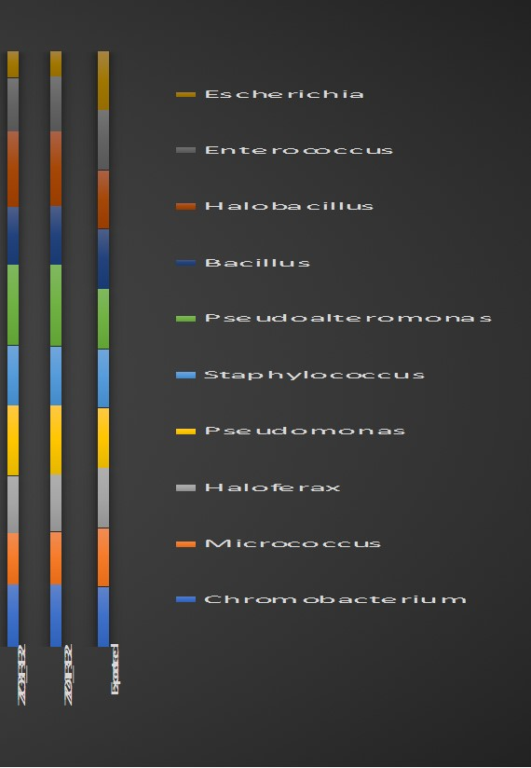
Bray-Curtis as a Performance Metric for Relative Abundance
Quantitative Performance Metric
Is the relative abundance reported for each strain/component correct?
Ground Truth = 10% for each component

Slide 27
Non-Euclidean Distance from Ground Truth (10%)

Slide 28
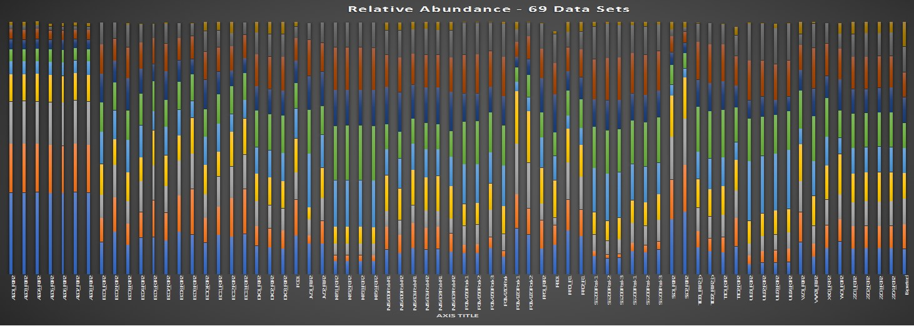
Non-Euclidean Distance from Ground Truth (10%)

Slide 29
Current/Future Work on MVP Data
Multi-Factorial Analysis of Variance (ANOVA)
Library Preparation Technique
Sequencing Instrument
Lab/Technician
Read Length
%GC Content (quantitative variability)
All data will be made publicly available once we have our manuscript submitted

Slide 30


Slide 31
Let’s Talk Bioinformatics Specifically, Metagenomic Profiling Tools..

Slide 32
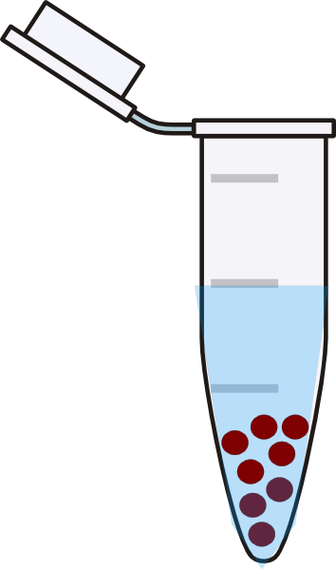
Bias in Metagenomic Measurements
Starting Sample
Total DNA
DNA Extraction
NGS Library
Shotgun Metagenomics
NGS
Bioinformatics
Transposon
Mechanical Shearing
Nuclease
Adapter Ligation
PCR-Bias
Sample Handling:
Isolation
Storage
Shipping
DNA Extraction Efficiency:
Different Extraction Efficiencies from Different Cell Types.
Different DNA Extraction Methods (bead beating vs. enzymatic vs. chaotropic, etc.)
Extracellular Matrix “Goop”
Bioinformatic Interpretation of the NGS Data:
Different Bioinformaticists Analyze and Interpret the Data Differently
Next-Gen Sequencing:
Different Platforms Exist. Each With Inherent Biases

Slide 33

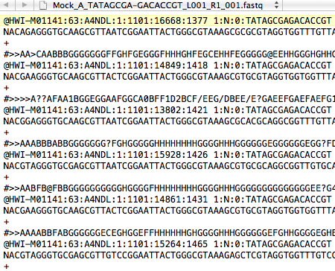
All Metagenomic Profiling Tools Do Something Similar to This….

Slide 34
How Comprehensive are our Reference Databases?
We can only “see” what is in our reference databases
So, how representative are the reference databases?
Currently, we have genome sequence data for ~35,000 different species in NCBI (~25,000 microbial species)
Need to know how many different species exist on earth..
Any guesses?

Slide 35

Reference Genome Databases
Recent estimates of the number of species on Earth range from 3.6x10⁴ to 1x10¹²
So our current databases represent anywhere from 99% to 0.0001% of all species on Earth

Slide 36
Bioinformatic Tools
Different Metagenomic Analysis Tools Use Different Algorithms, Statistics, and Reference Databases
As a result, different analysis tools will give you different answers

Slide 37
Too many tools, too few comparisons
IMMSA (2017): At least 71 tools available for profiling microbial communities using NGS
https://microbialstandards.org/index.php/bioinformatic-resources
Notes:
There are now at least 71 bioinformatics tool for whole genome shotgun taxonomic profiling, according to this very nice, up-to-date list on the new International Metagenomics and Microbiome Standards Alliance website.

Slide 38
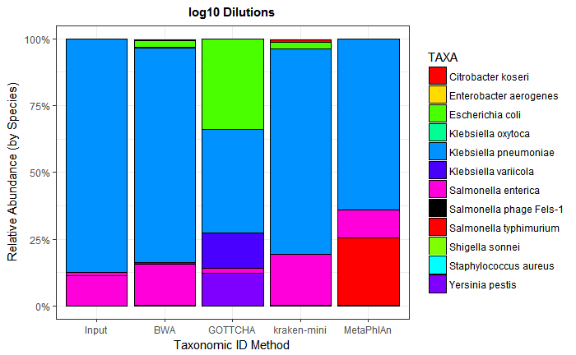
Dilutions for LOD Testing
Log10 Dilutions
K. pneumonia (90%)
S. enterica enterica (9%)
S. enterica arizonae (0.9%)
S. aureus (0.09%)
P. aeruginosa (0.009%)
A. baumannii (0.0009%)
Set cutoff (0.05%)
¾ tools ID S. aureus
False (+) rates vary
Species
Notes:
Apologize for the horrible colors.

Slide 39
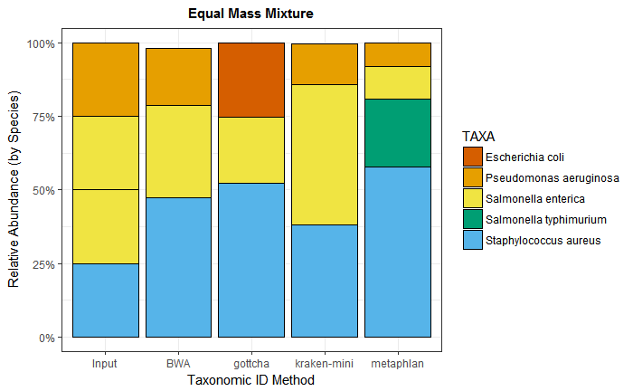
Metagenomics of Mixed Microbial DNA
Correlate input:output
Example: equal mass mixture
S. enterica enterica
S. enterica arizonae
S. aureus
P. aeruginosa
Results
Biasing (sample prep.)
Misclassifications
Need in silico data comparison

Slide 40
“Profiling the Profilers” Evaluating Metagenomic Data Analysis tools
Tools typically trade-off strengths and weaknesses

Slide 41
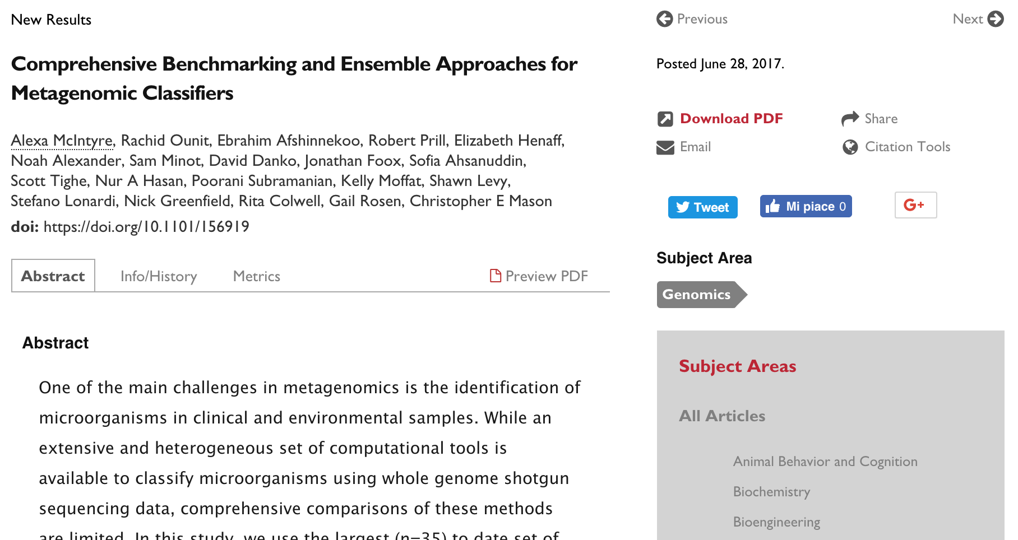
Profiling the Profilers
https://ftp-private.ncbi.nlm.nih.gov/nist-immsa/IMMSA/
Notes:
Also mention CAMI study

Slide 42
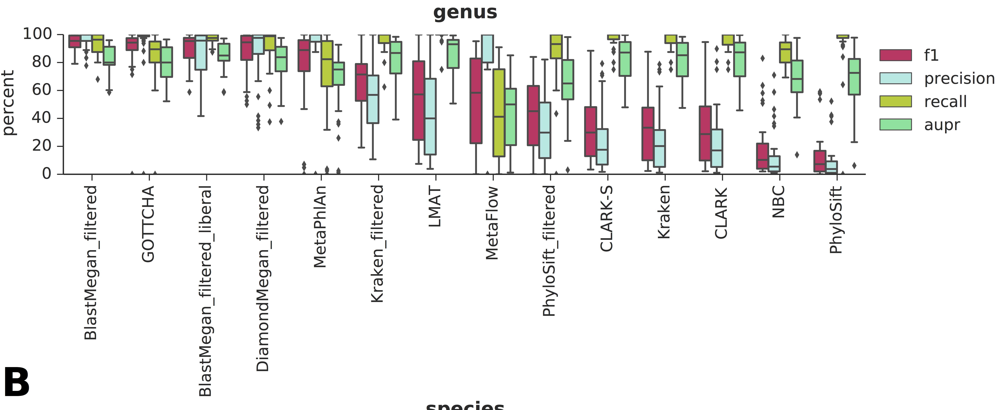
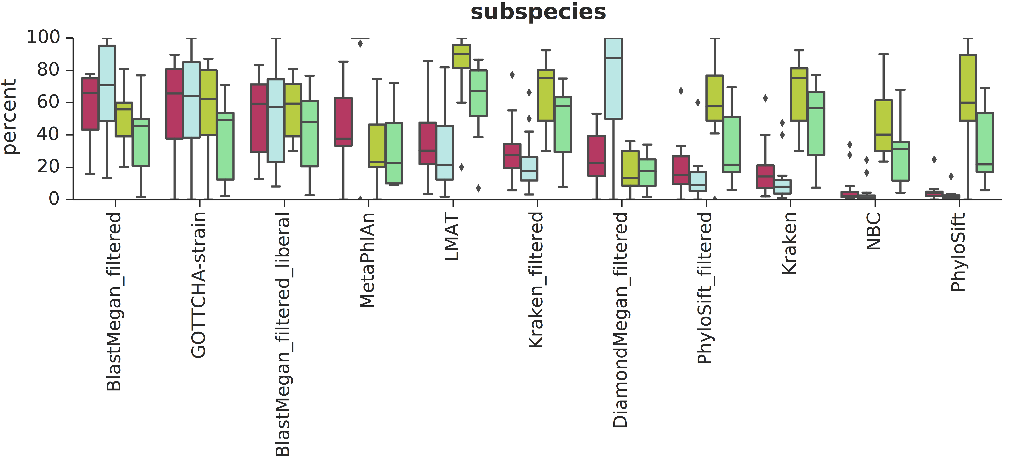
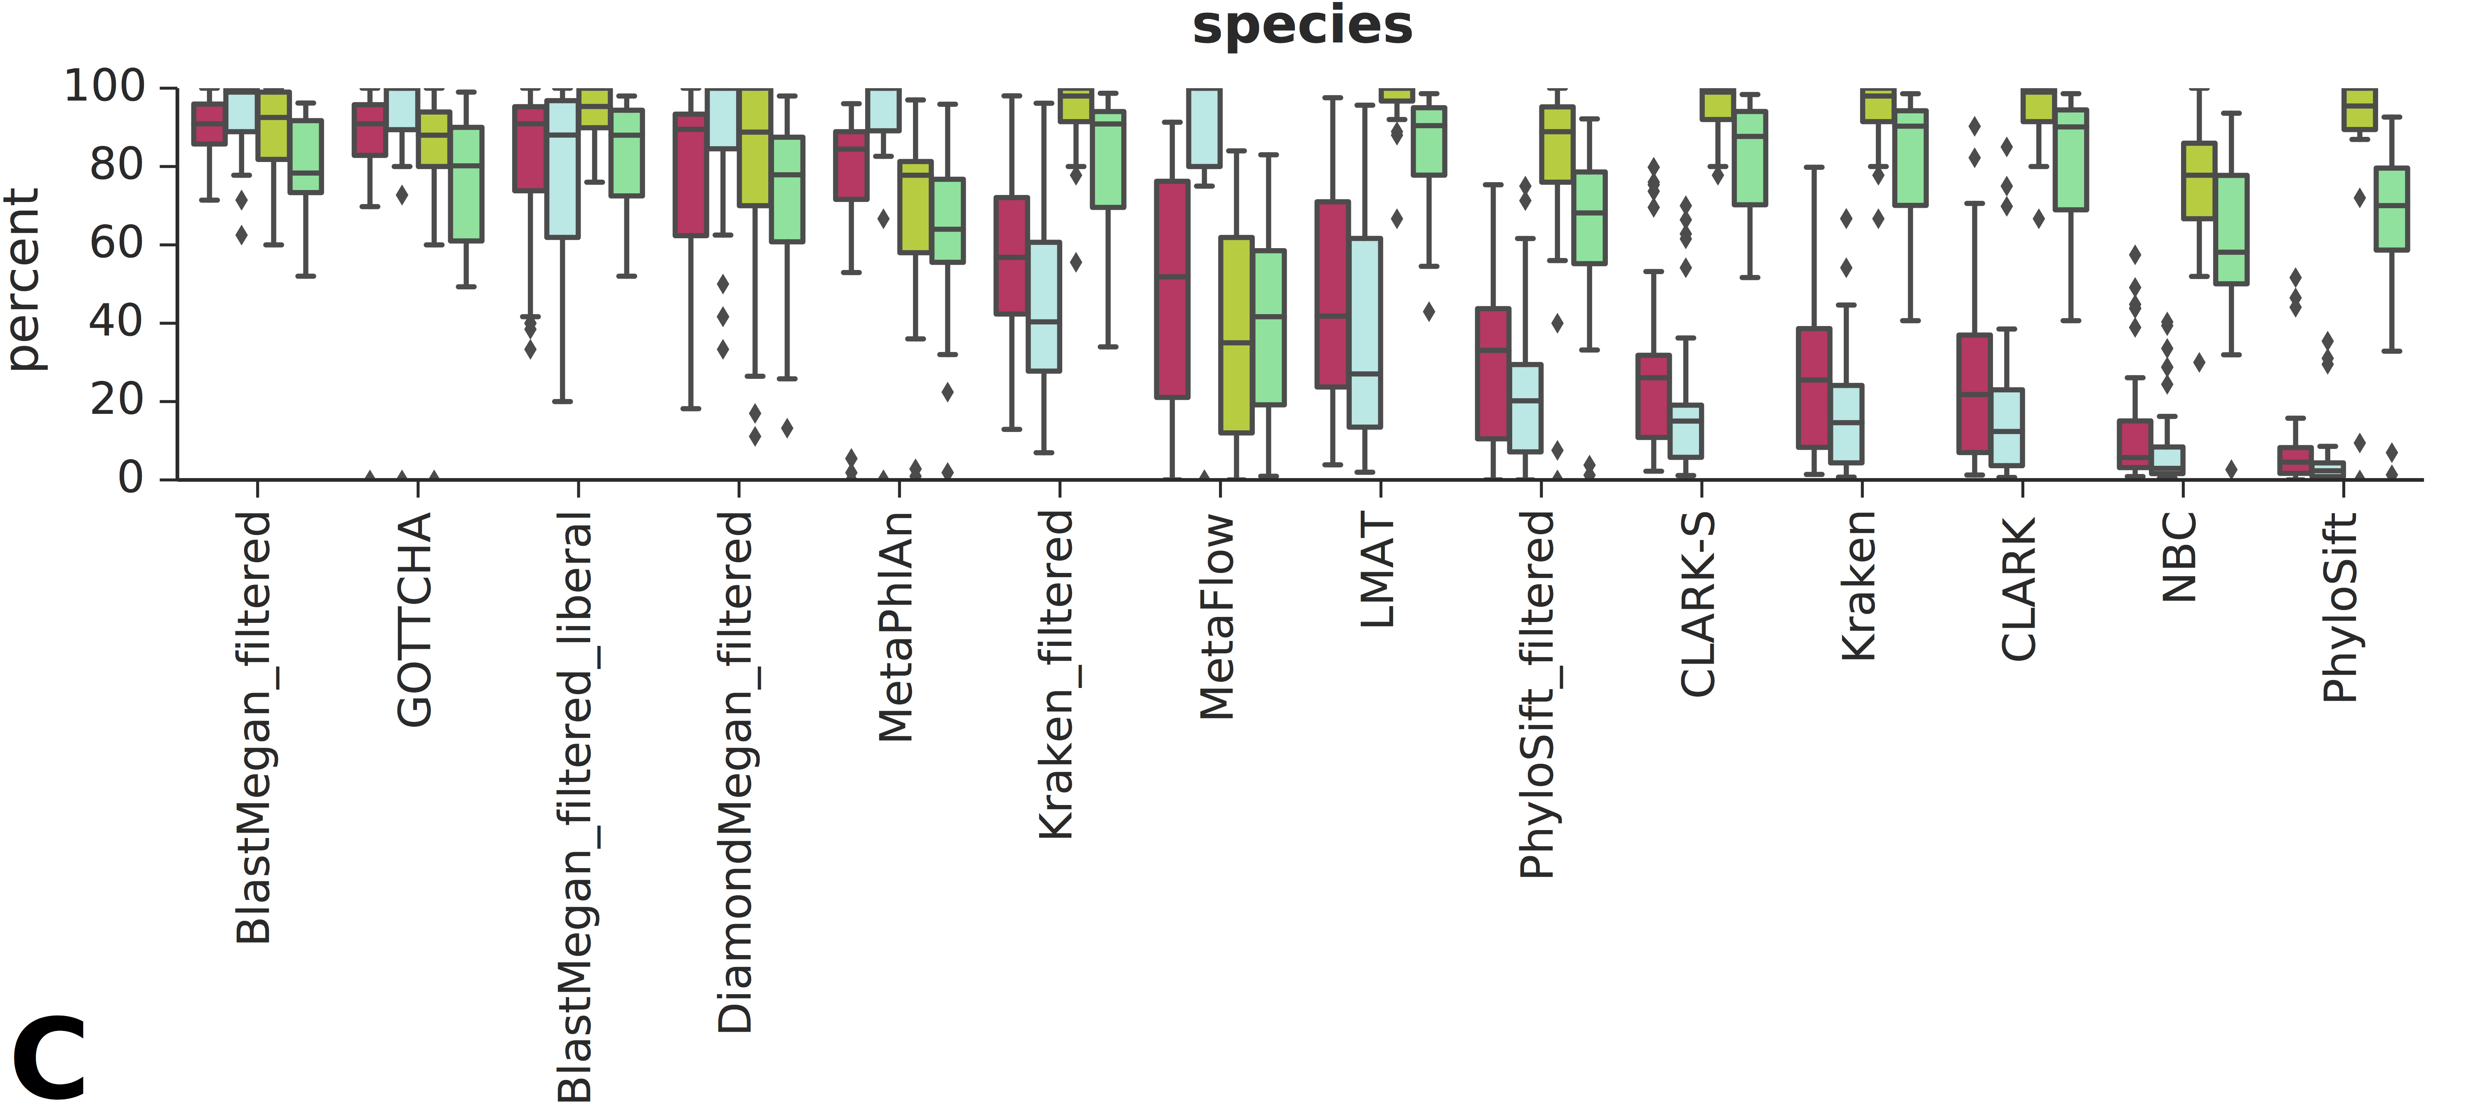
Performance profiles across 35 datasets
Precision = false positive rate = TP/(TP+FP)
Recall = sensitivity = TP/(TP+FN)
F1 score = 2(precision*recall)/(precision+recall)
AUPR = area under the precision recall curve
Notes:
We focused on the three lowest levels of taxonomic classification as the most clinically relevant, and calculated precision, recall, F1 score (or the harmonic mean between the two), and the area under the precision-recall curve.
We used 35 dataset s from a variety of sources, both seqeunced data and simulated data used in past evaluations
All tools performed best at the genus level (45.1% ≤ mAUPR ≤ 86.6%, Figure 1a), with small decreases in performance at the species level (40.1% ≤ mAUPR ≤ 84.1%, Figure 1b). Calls at the subspecies (strain) level showed a more marked decrease on all measures for the subset of datasets that included complete strain information (17.3% ≤ mAUPR ≤ 62.5%, Figure 1c).

Slide 43
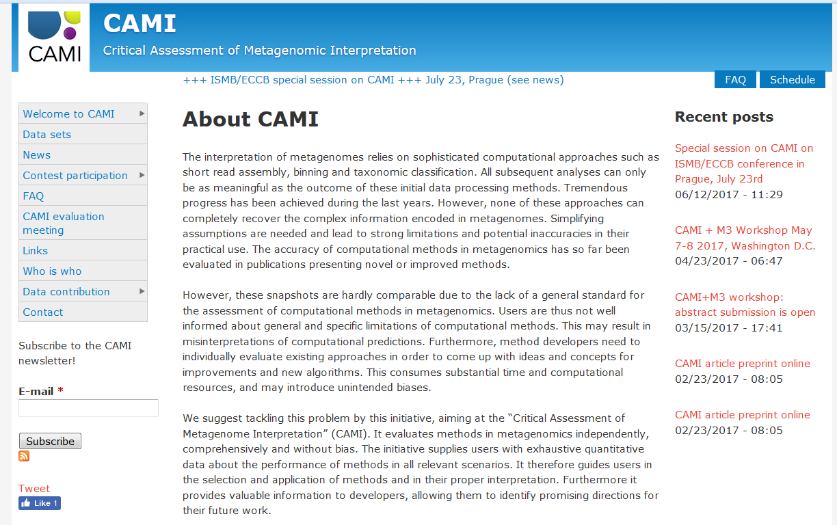
CAMI: Critical Assessment of Metagenomic Interpretation

Slide 44
NIST Metagenomic Reference Material Development

Slide 45
Clinical Diagnostics for Infectious Disease
‘NIST is currently developing microbial reference materials…. will be a “valuable tool for use..” in evaluating new diagnostic devices. ‘

Slide 46
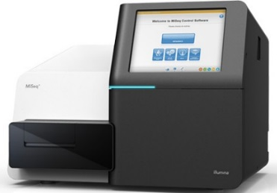
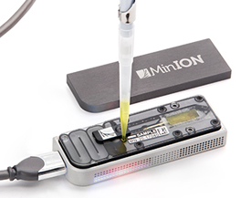
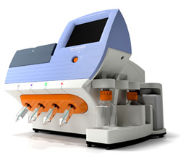
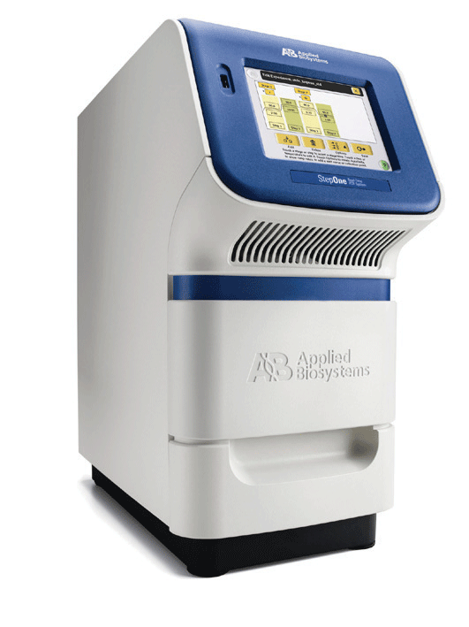
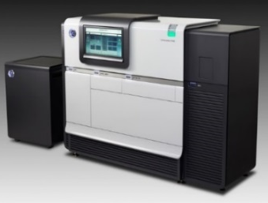
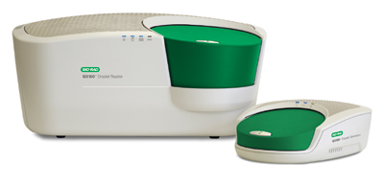
Targeted (PCR) Based Detection and NGS-Based Metagenomic Detection

Slide 47
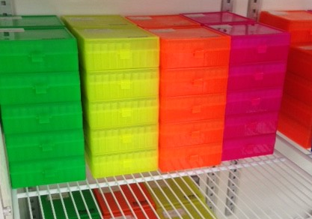
Candidate RM 8376 (Available Summer 2018)
Number | ID | Genus | species | subspecies | Received | Accepted | Sequenced |  | Mbases | Coverage | Assembly
MG-001 | ATCC 43895 | Escherichia | coli
MG-002 | ATCC BAA 2309 | Escherichia | coli
MG-003 | ATCC 700720 | Salmonella | enterica | enterica | Yes | Yes | Yes |  | 2900 | 469 | high quality
MG-004 | ATCC 12324 | Salmonella | enterica | arizonae | Yes | Yes | Yes |  | 534 | 71 | high quality
MG-005 | ATCC BAA 44 | Staphyloccus | aureus |  | Yes | Yes | Yes |  | 748 | 164 | high quality
MG-006 | ATCC 12600 | Staphyloccus | aureus |  | Yes
MG-007 | ATCC 12228 | Staphyloccus | epidermidis |  | Yes | Yes
MG-008 | ATCC BAA 47 | Pseudomonas | aeruginosa |  | Yes | Yes | Yes |  | 282 | 41 | standard
MG-009 | ATCC 19606 | Acinetobacter | baumannii |  | Yes | Yes
MG-010 | ATCC 13077 | Neisseria | meningitidis
MG-011 | ATCC 25177 | Mycobacterium | tuberculosis
MG-012 | ATCC 43504 | Helicobacter | pylori
MG-013 | ATCC 12344 | Streptococcus | pyogenes |  | Yes
MG-014 | ATCC 19433 | Enterococcus | faecalis |  | Yes
MG-015 | ATCC 33291 | Campylobacter | jejuni
MG-016 | ATCC 27061 | Achromobacter | xylosoxidans |  | Yes | Yes
MG-017 | ATCC 35654 | Aeromonas | hydrophila
MG-018 | ATCC 13883 | Klebsiella | pneumoniae |  | Yes | Yes | Yes |  | 164 | 15.6 | standard
MG-019 | ATCC 25931 | Shigella | sonnei |  | Yes | Yes
MG-020 | ATCC 9006 | Haemophilus | influenzae
MG-021 | ATCC 35016 | Vibrio | furnissii |  | Yes | Yes
MG-022 | ATCC 19115 | Listeria | monocytogenes |  | Yes
MG-023 | ATCC 49368 | Corynebacterium | amycolatum |  | Yes
MG-024 | ATCC 33152 | Legionella | pneumophila
MG-025 | ATCC 17857 | Clostridium | difficile
HG-001 | GM 24385 | Homo | sapiens

Slide 48

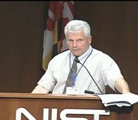



Acknowledgements
CosmosID
Nur Hasan
Kelly Moffat
Manoj Dadlani
FDA
Kelly Moffat
Scott Tighe
Heike Sichtig
Brittany Goldberg
MRI Global
Nur Hasan
Jonathan Jacobs
Sam Forry
Jason Kralj

Slide 49


NIST-NRC Postdoctoral Positions Available
National Research Council (NRC)
US Citizens ONLY
Within 5 years of PhD
2 years @ $67,588/y
Research Opportunities
Title
Mixed Pathogen Detection
Rapid Pathogen Detection
Tools to Predict the Emergence and Spread of Anti-Microbial Resistance
Inquire for details:
Scott Jackson scott.jackson@nist.gov

Slide 50

Questions?
Scott Jackson scott.jackson@nist.gov
#NISTPathogen
#NISTMicrobiome

Slide 51
NIST Workshops: Standards for Metagenomics

Slide 52

NIST-FDA Workshop: Standards for Pathogen Detection via NGS
October 2015
“The purpose of this workshop is to seek input on defining reference materials, reference data and reference methods for assessing analytical sensitivity, specificity, and relative performance of NGS-based pathogen detection devices/assays. These reference materials will be critical in addressing the challenges associated with mixed pathogen detection in complex samples (i.e. clinical) using shotgun metagenomic sequencing and targeted resequencing (culture-independent diagnostics) approaches.”
#NISTPathogen

Slide 53
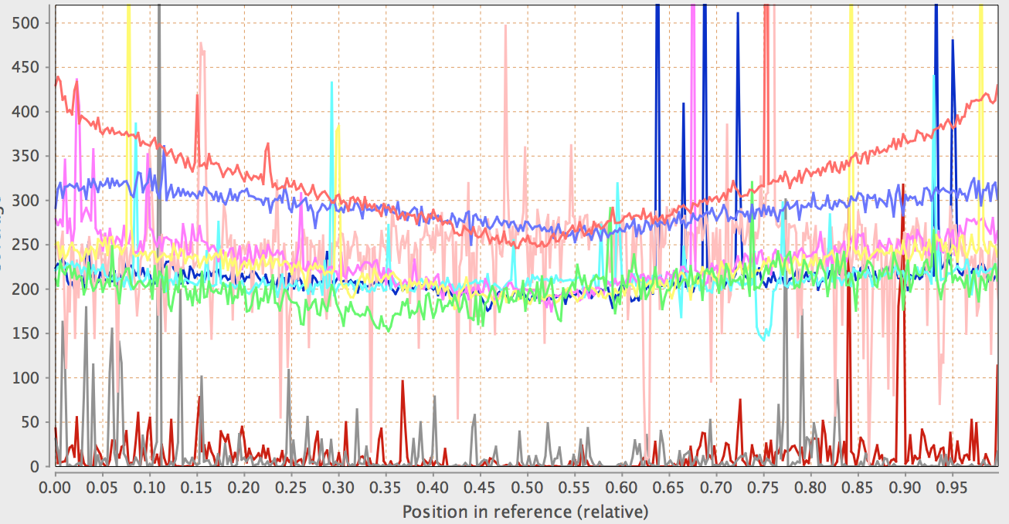
Reads Mapped to Reference Genomes Using Bowtie
HiSeq 2500 Data
69 Million Reads

Slide 54
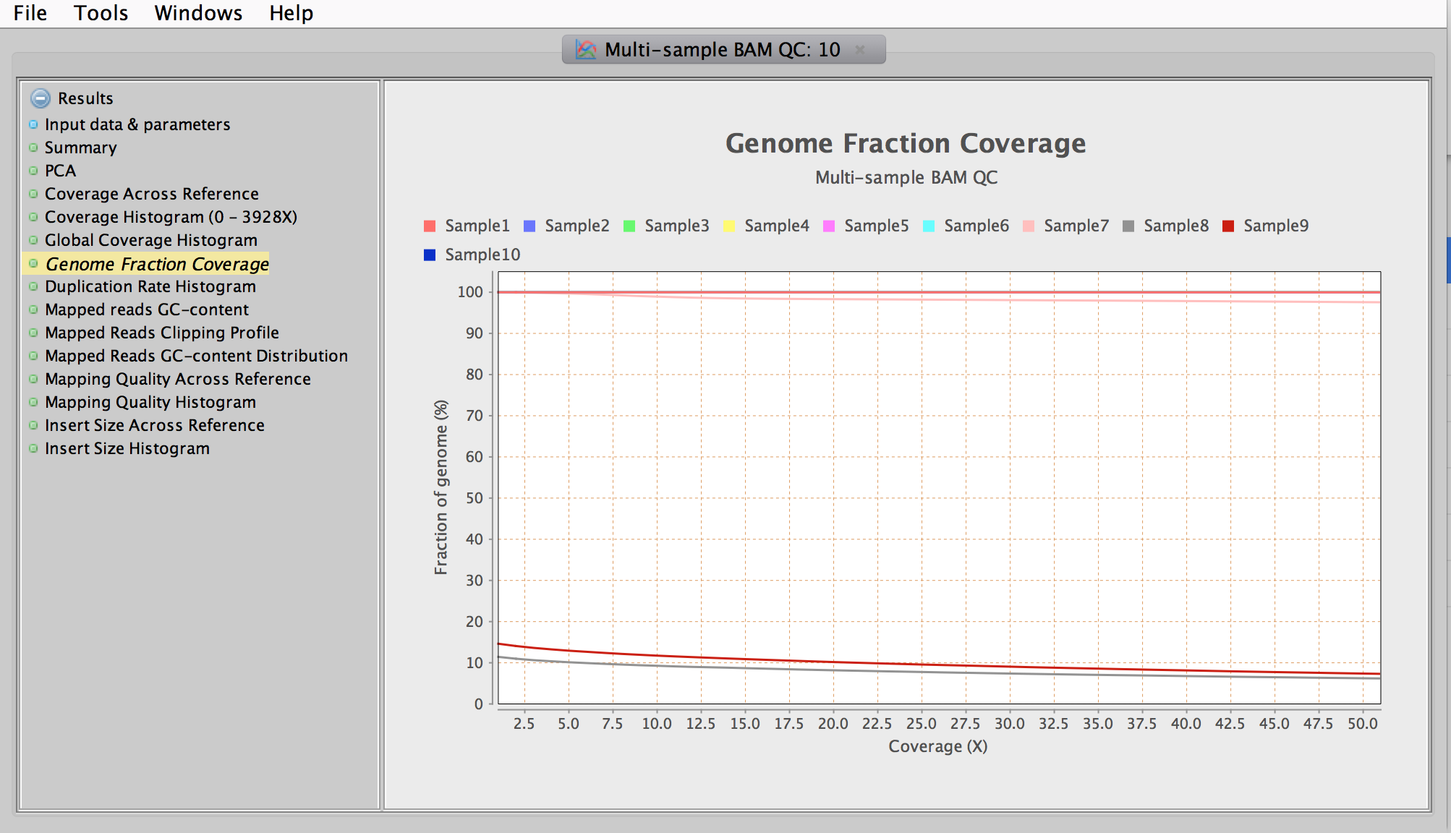
Genome Fraction Coverage: Reads Mapped to Reference Genomes Using Bowtie
HiSeq 2500 Data
69 Million Reads

Slide 57
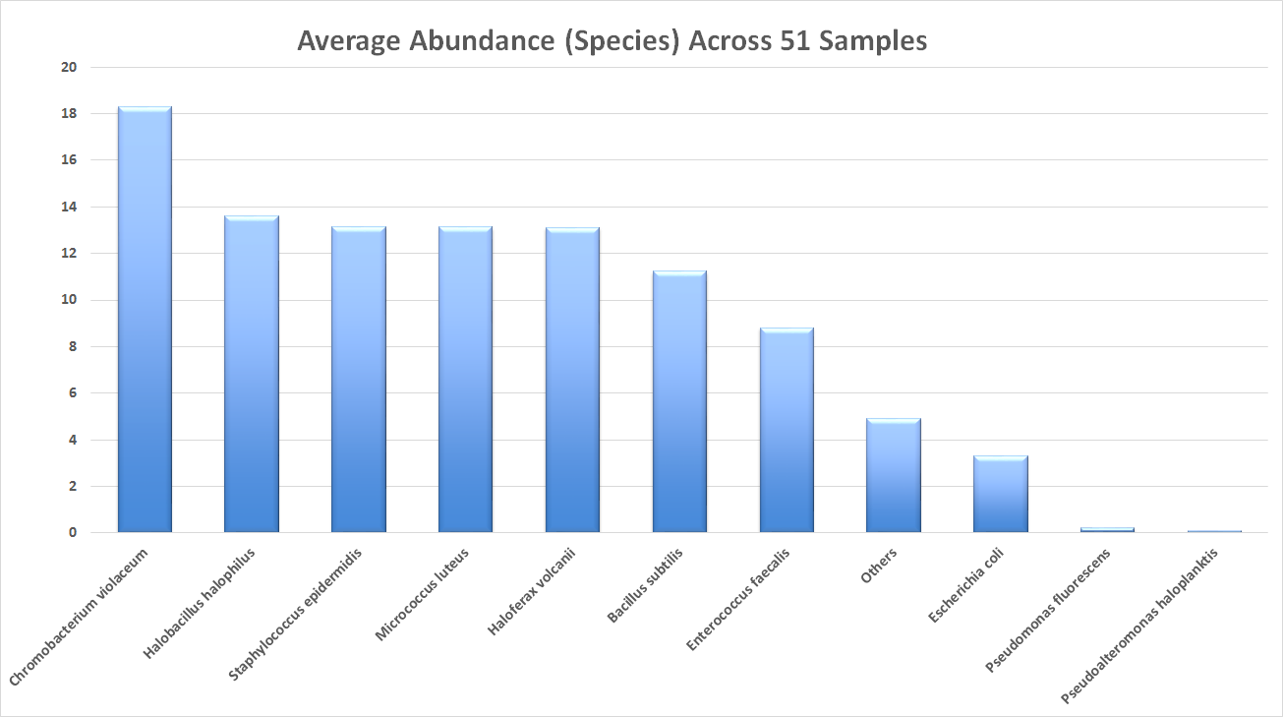
From CosmosID Relative Abundance Analysis

Slide 58
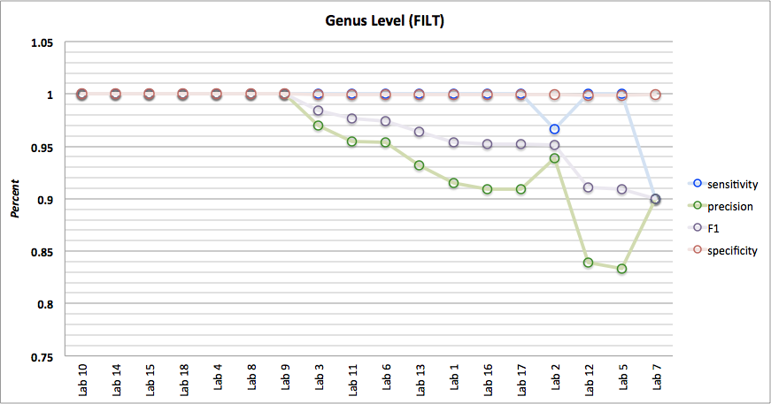

Slide 59
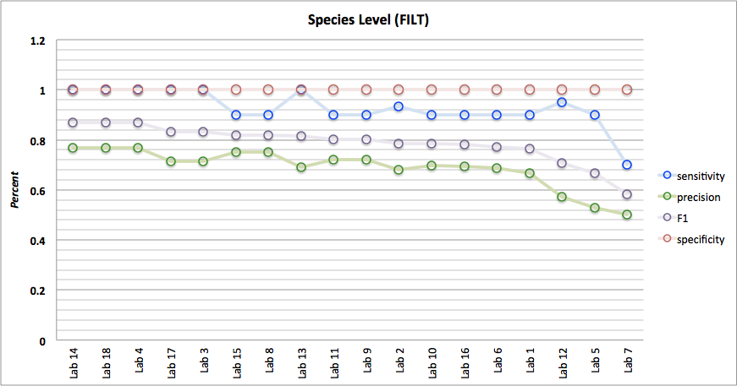

Slide 60
https://MicrobialStandards.org

Slide 61
The (New) Microbial Metrology Program @ NIST
Engineering Biology
Microbiome Community Measurements
Microbial Metrology
Biofilms
Combatting Antibiotic Resistance
Pathogen Detection and Identification

Slide 62
A New Metric: The Resistance Potential
Capability to Predict the Lifetime of a New Antibiotic
“Mean Time to Failure” for Antibiotics
Identify Biological Factors Responsible for (Rapid) Emergence
Identify Environmental Factors Responsible for (Rapid) Emergence
Allows for the Deployment of the “Best” Antimicrobial Therapies
Notes:
Impact slide:
We will always nee to develop antibiotics.
1.- Pharma companies will invest again
2.- new targets
3.- how to use the anitbiotics

Slide 63
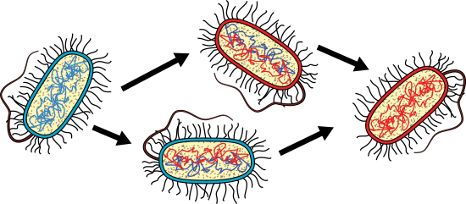
Measuring Resistance Potential = Measuring Bacterial Evolution
Transition State
Introduce Antibiotic
Antibiotic Resistant Bacteria
Antibiotic Sensitive Bacteria

Slide 64
Measuring Resistance Potential = Measuring Bacterial Evolution
Transition State
Introduce Antibiotic
Antibiotic Resistant Bacteria
Antibiotic Sensitive Bacteria
Notes:
we wil measure the transition. Until now it was only before and after.
This has never been done before because ….
It is not just specific mutations. There is much more, this is naïve, there is molecular drivers that are not known
Different conditions that affect population dynamics, and mutation rates.

Slide 65
The Technical Plan: Develop Tools Needed to Measure the Transition from Antibiotic Sensitivity to Antibiotic Resistance
In Other Words – Tools for Measuring Microbial Evolution

Slide 66

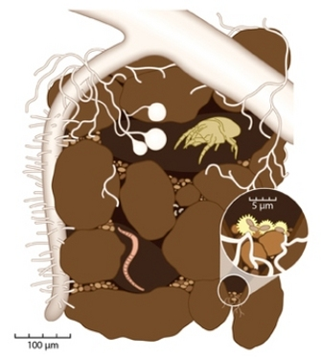
Bacteria Live and Evolve in Heterogeneous MicroEnvironments

Slide 67
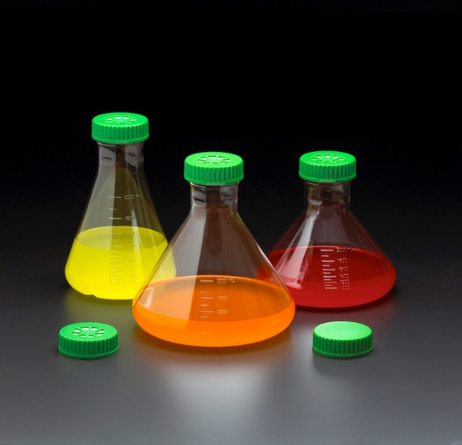
Homogeneous (Laboratory) Environments Do NOT Mimic Natural Environments

Slide 68
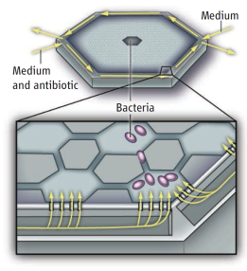
The Technical Plan:
Engineered Microenvironments
Mimics real world
Evolution happens differently (more rapidly?) in complex environments

Slide 69



Engineering Custom Microenvironments
Leverage the NIST Center for Nanoscale Science and Technology (CNST) to manufacture custom microenvironments with novel features
Establish microbial environments:
Chemical Gradients
Temporal Variation
Complex Microbial Communities
Stressful Environments (mutagens, pH, O₂)
“Island” Environments
Microscopy

Slide 70





The Overall Technical Plan
Engineered Microenvironments
real-world relevance
Microscopy
real-time monitoring
Genomics
genetic changes and population dynamics
Transcriptomics
molecular mechanisms of the transition state
Metabolomics
phenotypic response
Modeling and Theory
enable predictions and decision-making
Genomics
Microscopy
Complex Microenvironments
Transcriptomics
Metabolomics
Evolutionary Biology
Genome-Scale Modeling

Slide 71

Proof of Concept @ NIST
Bacteria Exposed to a Exponential Concentration Gradient of Antibiotic
Adapt or Die
Escherichia coli Evolved Resistance to Ampicillin in Less Than 24 Hours
An Engineered Microenvironment

Slide 72
(Simulated)
Resistance Potential Measured Using Controlled Microenvironments
Notes:
Multidimentional Valleys . A valley shows the lowest resistance potential; it shows how tit should be used.b

Slide 73
The (New) Microbial Metrology Program @ NIST
Engineering Biology
Microbiome Community Measurements
Microbial Metrology
Biofilms
Combatting Antibiotic Resistance
Pathogen Detection and Identification

Slide 74

Biofilms
Biomaterials Group
NIST is developing methods to quantify critical properties of biofilms and biofilm-material interactions.
Methods and statistical approaches to characterize and quantify biofilms and their response to external stimuli, such as soluble antimicrobial agents, substrate properties, and additional species of bacteria, will facilitate development, testing, and regulatory oversight for new technologies aimed to harness the promise of biofilms to address critical societal challenges.
* Some Funding by American Dental Association

Slide 75
The Microbial Metrology Key Strategies – 5 Year Outlook
Engineering Biology
Microbiome Community Measurements
Microbial Metrology
Biofilms
Combatting Antibiotic Resistance
Pathogen Detection and Identification

Slide 76





Engineering Biology
Customers and Partners
SERI Funding: $1M for 2 years to support Engineering Biology
2018 NIST Initiative: Engineering Biology
Science - 25 MARCH 2016 • VOL 351 ISSUE 6280
Science - 1 APRIL 2016 • VOL 352 ISSUE 6281
Pelletier and Strychalski
Vanya Paralanov, Elizabeth A. Strychalski, David Ross

Slide 77

Engineering Biology
An MML Strategic Priority (independent of the microbial metrology efforts)
“This approach seeks to harness the power of living matter for a variety of manufacturing applications including advanced therapeutics…”
Rationale: Developing the next generation of tools for biomanufacturing. Like integrated (in vivo) bioprocess control and diagnostics

Slide 78





David Ross
NIST-MML-644
Microfluidics
Theory
Modeling
CosmosID
Nur Hasan
Kelly Moffat
Manoj Dadlani
Javier Atencia
NIST-MML-644
UMD
Microfluidics and Engineered Bacterial Microenvironments
FDA
Heike Sichtig
Brittany Goldberg
Jason Kralj
Nancy Lin
MRI Global
Jonathan Jacobs
Scott Jackson
NIST-MML-644
Microbiology
Genomics
Bioinformatics
Sam Forry
Nate Olson

Slide 79
While at FDA……
“To develop forensic tools that will allow the detection, identification, and tracing of pathogenic strains of Escherichia coli, Shigella, Salmonella, Campylobacter, Vibrio, and other enteric pathogens that may be used to contaminate the nation’s food supply.”
……with DHS

Slide 80

RM Characterization
Each tube will contain a single genome and will be characterized for the following metrics:
Tube Rack – 25 Tubes
1
2
3
4
5
Genome Assembly – Long Read Sequencing
Base Level Purity (i.e. Rare Variants)
Deep Illumina Sequencing
Genomic Contaminants
Environmental/Reagent/Platform Contaminants
Quantity (concentration in ng/µl)
Infer genomes per µl
DNA Stability
6
7
8
9
10
11
12
13
14
15
16
17
18
19
20
21
22
23
24
25

Slide 81
Purpose of the Mixed Microbial DNA RM
Assess the analytical sensitivity and specificity of NGS-based metagenomic analyses for pathogen detection
Process development
Regulatory oversight
Enable reproducibility through reference materials
Stable composition and concentration
Including access to characterization data
Notes:
Our purpose for developing this material is to improve our understanding of the sensitivity and specificity of metagenomic analyses. This benefits both those who develop new sequencing and informatics tools and regulatory/oversight groups who must confirm the claims made by tool developers before they can be ready for general use by decision makers.
For all this to happen, a consistent resource of a reference sample/material is required.
Each DNA we produce comes from a single lot, and will have stable compositions and concentrations. Perhaps most importantly, the data associated with characterization will be publicly available. This will include the concentration, size, and sequencing data, and associated metadata.

Slide 82



Organism-level Purity Analysis of “Pure” Salmonella Genomic DNA
Credit: Nate Olson
Analysis done via Pathoscope

Slide 83



Calculate Base-Level Purity
Sequencing Reads
Align to
Reference

Slide 84

Base Level Purity: Results MG001
19 out of 4.8 Mb have purity values less than 0.98 for both platforms
5 positions with purity less than 0.95

Slide 85

Base Level Purity: Results MG001

Slide 86
“There’s no such thing as a pure culture”
Someone, Sometime

Slide 87
Metagenomics of Mixed Microbial DNA
Correlate input:output
Example: equal mass mixture
S. enterica enterica
S. enterica arizonae
S. aureus
P. aeruginosa
Results
Biasing (sample prep.)
Misclassifications
Need in silico data comparison

Slide 88
Dilutions for LOD Testing
Log10 Dilutions
K. pneumonia (90%)
S. enterica enterica (9%)
S. enterica arizonae (0.9%)
S. aureus (0.09%)
P. aeruginosa (0.009%)
A. baumannii (0.0009%)
Set cutoff (0.05%)
¾ tools ID S. aureus
False (+) rates vary
Species
Notes:
Apologize for the horrible colors.

Slide 89

Looking ahead
In silico experiments to complement experimental work
Simulated and subsampling/mixing reads
Statistically significant numbers of experiments
Interlaboratory studies to develop & evaluate mixtures
Limit of detection/quantitation
Discriminating near neighbors
Additional DNA needs
Other organisms (viruses, fungi)
Expansion of existing panel
WE WANT YOU!
FOR METAGENOMICS

